Slide 1

What is Module?
A Python module is a file containing Python definitions and statements. A module can define functions, classes, and variables. A module can also include runnable code. Grouping related code into a module makes the code easier to understand and use. It also makes the code logically organized.
We can import the functions, and classes defined in a module to another module using the import statement in some other Python source file.
Locating Python Modules
Whenever a module is imported in Python the interpreter looks for several locations. First, it will check for the built-in module, if not found then it looks for a list of directories defined in the sys.path. Python interpreter searches for the module in the following manner –
First, it searches for the module in the current directory.
If the module isn’t found in the current directory, Python then searches each directory in the shell variable PYTHONPATH. The PYTHONPATH is an environment variable, consisting of a list of directories.
If that also fails python checks the installation-dependent list of directories configured at the time Python is installed.

Slide 2
Advantages of Python Package
aming conflicts can be solved easily.
We can identify our components uniquely.
Improves the Modularity of the application.
The readability of the application will be improved.
Maintainability of the application will be improved.

Slide 3
What is Packages?
What is a Python Package?
Python modules may contain several classes, functions, variables, etc. whereas Python packages contain several modules. In simpler terms, Package in Python is a folder that contains various modules as files.
To create this module follow the below steps:
Create a folder named mypckg.
Inside this folder create an empty Python file i.e. __init__.py
Then create two modules mod1 and mod2 in this folder.

Slide 4
Advantages of Python Packages
Reusability:Working with modules makes the code reusable.
Simplicity:The module targets a small proportion of the problem rather than aiming at the complete problem.
Scoping:A Module defines a distinct namespace that supports avoiding collisions between identifiers.

Slide 5
Difference between module and package
A Package consists of the __init__.py file for each user-oriented script. However, the same does not apply to the modules in runtime for any script specified to the users.
A module is a file that contains a Python script in runtime for the code specified to the users. A package also modifies the user interpreted code in such a manner that it gets easily operated in the runtime.
Let us see come example off python package to know more about Modules and packages

Slide 6
RE Module in Python
A Regular Expressions (RegEx) is a special sequence of characters that uses a search pattern to find a string or set of strings. It can detect the presence or absence of a text by matching it with a particular pattern, and also can split a pattern into one or more sub-patterns. Python provides a re module that supports the use of regex in Python. Its primary function is to offer a search, where it takes a regular expression and a string. Here, it either returns the first match or else none.

Slide 7
Fetures Of RE Module
A regular expression is a special sequence of characters that helps you match or find other strings or sets of strings, using a specialized syntax held in a pattern. Regular expressions are widely used in UNIX world.
The Python module re provides full support for Perl-like regular expressions in Python. The re module raises the exception re.error if an error occurs while compiling or using a regular expression.
We would cover two important functions, which would be used to handle regular expressions. But a small thing first: There are various characters, which would have special meaning when they are used in regular expression. To avoid any confusion while dealing with regular expressions, we would use Raw Strings as r'expression'.

Slide 8
Various Regex Meta charecters
[] | A set of characters | "[a-m]"
\ | Signals a special sequence (can also be used to escape special characters) | "\d"
. | Any character (except newline character) | "he..o"
^ | Starts with | "^hello"
$ | Ends with | "planet$"
* | Zero or more occurrences | "he.*o"
+ | One or more occurrences | "he.+o"
? | Zero or one occurrences | "he.?o"
{} | Exactly the specified number of occurrences | "he.{2}o"
| | Either or | "falls|stays"
() | Capture and group

Slide 9
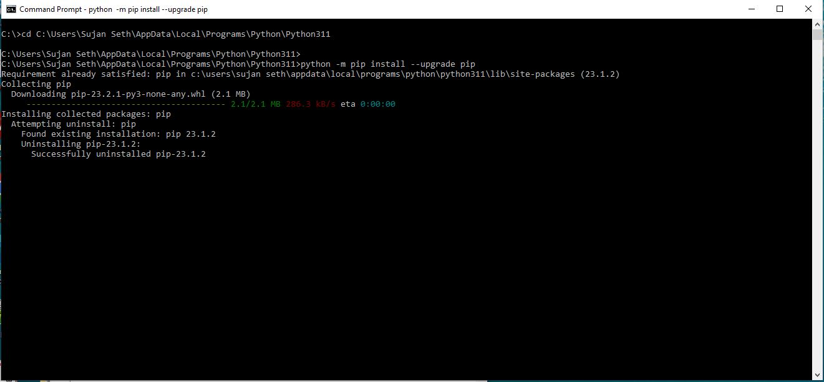
Installation of PIP

Slide 10
Thank You very much for attending this presentation
If you have any question you are free to ask

